Slide 1
Service Fabric: A Platform for Building and Managing Highly Scalable Services
Shawn Weisfeld
shawn@shawnweisfeld.com
http://www.shawnweisfeld.com

Slide 2







About Me
Founder of UserGroup.tv
Technical Evangelist at Microsoft

Slide 3


Watch User Group presentations for FREE online!
All the topics you care about
Including:
Agile
C#
Entity Framework
HTML5
MVC
Silverlight
XAML
jQuery
and Much More!
Miss a User Group meeting?
Forget something that you learned?
Want to see content from a User Group not in your area?
Want to share with a buddy?
We know you cannot make it to every User Group meeting,
that is why we post them online for you!
We now have over 500 presentations online
That is over 100 GB of video
New Content added all the time!
Presentations from the thought leaders on the topic.
For new content announcements
@UserGroupTV
http://www.UserGroup.tv

Slide 4
Want to go to VS Live in Boston?
June 13-16
Got to http://usergroup.tv and click on “Win a Ticket” for details.
Register for VSLive Austin for 4 days of #dotNET training, May 16-19! Save $500 w/code AUUG03: http://bit.ly/AUUG03Home

Slide 5
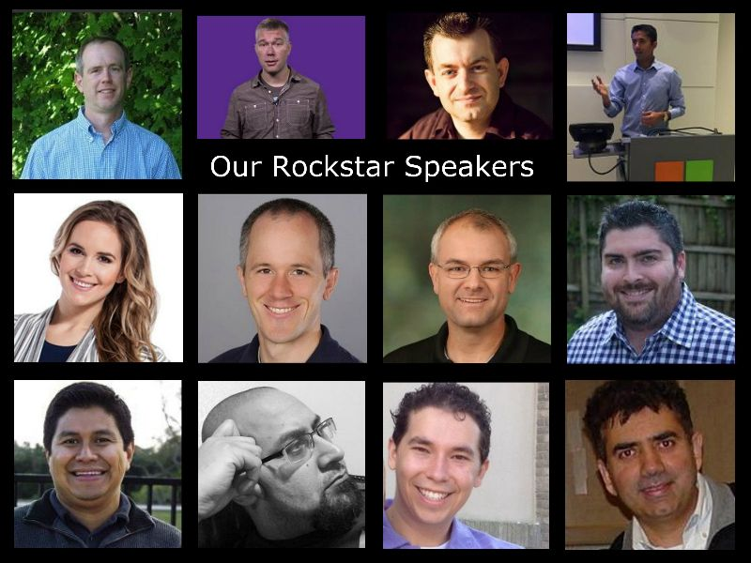
WHAT IS MVP MIX?
Use Discount Code “meetup”
Dallas on May (27 – 28), 2016
MVP MIX is a 2-day training in .Net, HTML5, JavaScript, EcmaScript, Web API and REST, iOS, Big Data, Redis, Elasticsearch (and other relevant No-SQL databases), and other awesome technologies.
MVP MIX is the Top .NET Conference in Southern US. With Keynote speakers from Microsoft and the community like Scott Hanselman, Rob Eisenberg, Scott Hunter, Phil Haack, Ayende Rahien, Todd Anglin, Stephen Bohlen and many others we bring to you the best in the industry right close to you.
http://mvpmix.com/

Slide 6
Agenda
Overview
Demo
Questions

Slide 7
Business needs today are simple:
Scale – our applications are spanning many different servers and sometimes even multiple datacenters.
Agility – more frequent releases of incremental changes.
Availability – 24/7 operations with no downtime for upgrades, patches, etc.
Density – drive costs down by increasing the utilization of every asset.

Slide 8


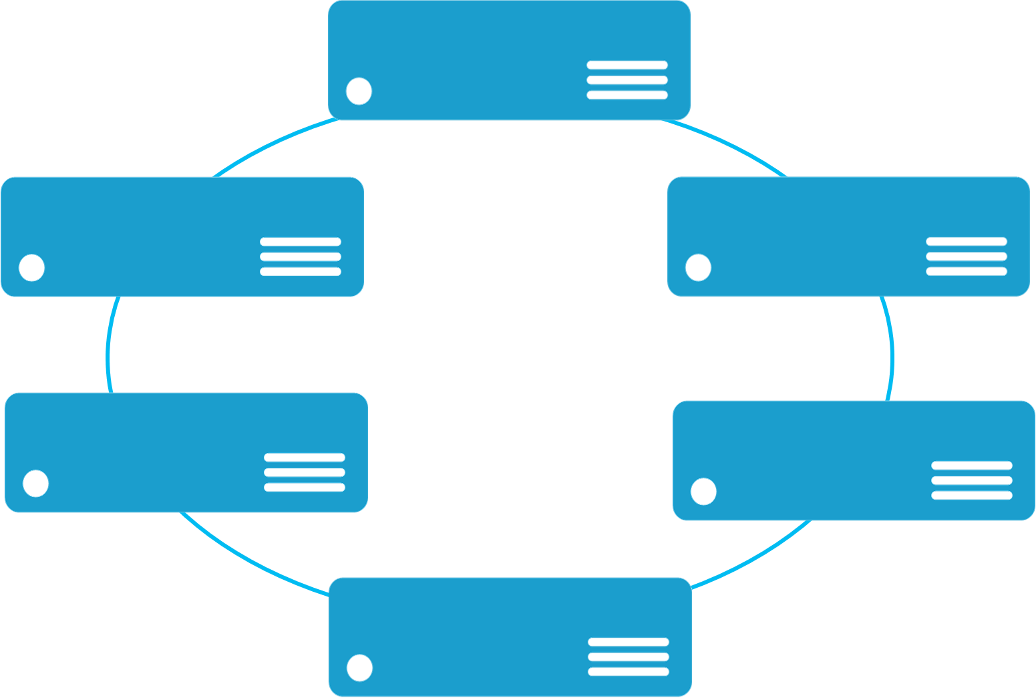


Monolithic application approach
Microservices application approach
A monolith app contains domain specific functionality and is normally divided by functional layers such as web, business and data
App 1
App 1
App 2
A microservice application separates functionality into separate smaller services.
Scales by cloning the app on multiple servers/VMs/Containers
Scales out by deploying each service independently creating instances of these services across servers/VMs/containers

Slide 9
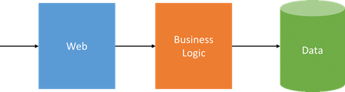
Three-Tier Monolithic Application
99.95%
99.95%
99.95%
Max Application SLA 99.85% (1.1 hr per month).

Slide 10
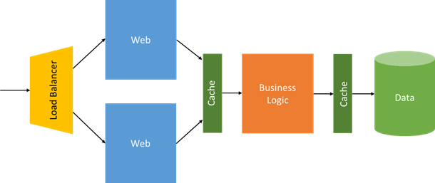
Three-Tier Monolithic Application @ Scale
99.9%
99.95%
99.9%
99.95%
99.95%
Max Application SLA 99.65% (2.6 hr per month).

Slide 11
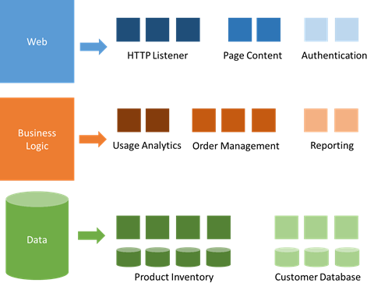
Decompose the Monolith into Microservices

Slide 12
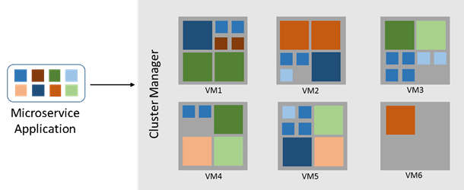
Deploy Microservices Across a Cluster
Cluster SLA 99.95%
(22 minutes per month).

Slide 13






3-Tier service pattern
Load Balancer
Scale with partitioned storage
Increase reliability with queues
Reduce read latency with caches
Manage your own transactions for state consistency
Many moving parts each managed differently
Front End
(Stateless
Web)
Stateless
Middle-tier
Compute
Cache
Queues Storage

Slide 14

Stateful services: Simplify design, reduce latency
Application state lives in the compute tier
Low Latency reads and writes
Partitions are first class for scale-out
Built in transactions
Fewer moving parts
Load Balancer
Front End
(Stateless
Web)
Stateful
Middle-tier
Compute
data stores used for analytics and disaster recovery

Slide 15






Cloud Service vs Stateful Service Fabric
Cloud Services
Service Fabric
(Stateful)
Reliable Azure Queue
Azure Tables/NoSQL

Slide 16
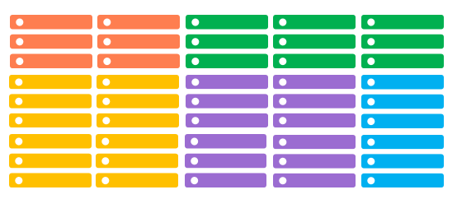
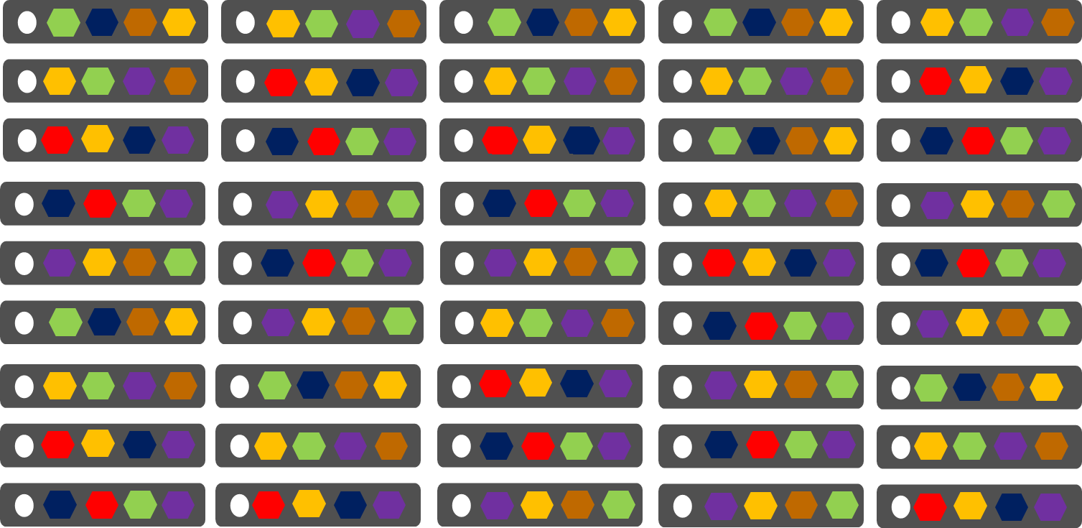
Comparing Azure Cloud Services vs. Azure Service Fabric
Azure Cloud Services
(Web and Worker Roles)
Azure Service Fabric
(Stateless, stateful or Actor services)
1 role instance per VM
Uneven utilization
Low density
Slow deployment & upgrade (bound to VM)
Slow scaling and failure recovery
Limited fault tolerance
Many microservices per VM
Even Utilization (by default, customizable)
High density (customizable)
Fast deployment & upgrade
Fast scaling of independent microservices
Tunable fast fault tolerance

Slide 17
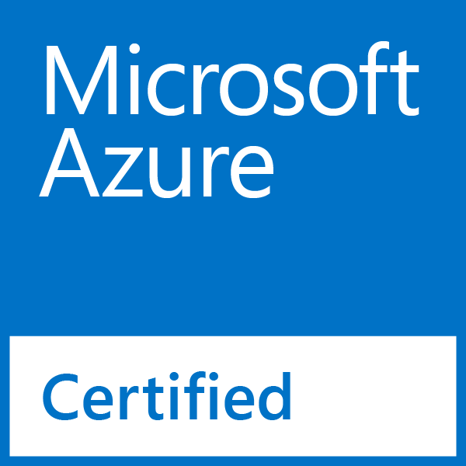
Options
Docker Swarm and Docker Compose
Kubernetes
Mesosphere DCOS, with Apache Mesos and Marathon
OpenShift
Pivotal Cloud Foundry
Service Fabric

Slide 18
Service Fabric
LifecycleMgmt
Independent Scaling
Independent Updates
Always On Availability
Resource Efficient
Stateless/
Stateful
Public Cloud
On Premises
Private cloud
Other Clouds

Slide 19
Deploy Service Fabric Microservices to:
Physical & Virtual Machines
Public Preview for Windows
Private Preview for Linux
Containers (coming soon)
Managed Service on Azure (in GA)
In your datacenter, private cloud or public cloud

Slide 20
Battle-hardened for over 5 years
Skype for Business
Hybrid Ops
Azure Document DB
billions transactions/week
Intune
800k devices
Azure Core Infrastructure
thousands of machines
Event Hubs
20bn events/day
Bing Cortana
500m evals/sec
Azure SQL Database
1.4 million databases
Power BI

Slide 21

Service Fabric Cluster
Datacenter (Azure, On Premises, Other Clouds )
PC/VM #2
Service Fabric
Your code, etc.
PC/VM #3
Management to deploy your code, etc. (Port: 19080)
Service Fabric
PC/VM #1
Your code, etc.
Service Fabric
PC/VM #4
Load Balancer
Your code, etc.
Service Fabric
Your code, etc.
PC/VM #5
App Web Request (Port: 80/443/?)
Service Fabric
Your code, etc.

Slide 22




Cluster: System view
System Services
Failover
manager
Cluster
manager
Naming
Image
store

Slide 23
Handling Machine Failures
#FAIL
App1
App2
App Type Packages
Service Fabric Cluster VMs

Slide 24
Stateful Microservices - Replication
Primary
Secondary
Replication
Service Fabric Cluster VMs

Slide 25
What is a SF microservice?
Is (logic + state) that is independently versioned, deployed, and scaled
Has a unique name that can be resolved
e.g. fabric:/myapplication/myservice
Interacts with other microservices over well defined interfaces and protocols like REST
Remains always logically consistent in the presence of failures
Hosted inside a “container” (code + config)
Can be written in any language and framework
node.js, Java VMs, any EXE
Developed by a small engineering team

Slide 26
Types of SF microservices
Stateless microservice
Has either no state or it can be retrieved from an external store
There can be N instances
e.g. web frontends, protocol gateways, Azure Cloud Services etc.
Stateful microservice
Maintain hard, authoritative state
N consistent copies achieved through replication and local persistence
e.g. database, documents, workflow, user profile, shopping cart etc.

Slide 27


What can you build with Service Fabric?
Stateless applications
A service that has state where the state is persisted to external storage, such as Azure databases or Azure storage
e.g. Existing web (ASP.NET) and worker role applications
Stateful applications
Reliability of state through replication and local persistence
Reduces latency
Reduces the complexity and number of components in traditional three tier architecture
Existing apps written with other frameworks
node.js, Java VMs, any EXE

Slide 28


State Architectures: Traditional vs Service Fabric
Stateless Web
Stateless Compute
Cache
Stateful Data
Other Internal Tiers ?
Load Balancer
Stateless Web
Stateful Compute
Load Balancer

Slide 29
Service Fabric Platform Capabilities
All code and programming models
Fast deployment
Placement and activation
Reliability
High density
Health reporting
Coordinated upgrades
Reliable Services programming model
Service endpoint discovery
Dynamic resource balancing based on actual resource usage
Integrated application patterns e.g. Actor pattern and WebApi
Visual Studio development e.g. F5 debugging, diagnostics events, package and deploy
Reliable Collections programming model
Highly-reliable and scalable state
Lower latency compared to external storage
Guest Executable (stateless) (i.e. Node.js, Java, .NET, etc.)
Reliable Service (stateless) (C#/.NET)
Reliable Collections (stateful) (C#/.NET)

Slide 30
Demo

Slide 31
Captain Smack Down App
Cluster
Node #1
Node #3
Website
Starship
Load Balancer
ApiGateway
Node #2
Node #4
Website
CrabBoat
ApiGateway

Slide 32
Takeaways
Microservices enable development and management flexibility
Service Fabric is the platform for building applications with a microservices design approach
Service Fabric is battle tested and provides a rich platform for both development and management of services at scale

Slide 33
Service Fabric @ //build 2016
Azure Service Fabric for Developers
Jeffrey Richter & Mark Fussell
https://channel9.msdn.com/Events/Build/2016/B874
Building MicroServices with Service Fabric
Matthew Snider
https://channel9.msdn.com/Events/Build/2016/T693

Slide 34


web browser
or device
Age of Ascent Architecture
CDN
Service Fabric Cluster
Gaia (stateless)
Avatar
(stateless)
32 Microservices
AI
Events
routing
services
physics
service
Account
Player
Commerce
Crew
Alliance
aggregate
services
game
function
services
Spatial
(In Space)
Trade Inventory Production
Navigation
Comms

Slide 35
Resources
Microservices: An application revolution powered by the cloud
By Mark Russinovich on 3/17/16
https://azure.microsoft.com/en-us/blog/microservices-an-application-revolution-powered-by-the-cloud/

Slide 36
Call to Action
Download the Service Fabric developer SDK
http://aka.ms/ServiceFabricSDK
Download the standalone Service Fabric preview for Windows Server
http://aka.ms/ServiceFabricWS2012R2
Learn from samples and complete solutions
http://aka.ms/ServiceFabricSamples
Signup for Service Fabric on Linux
http://aka.ms/SFlinuxpreview
Provide feedback
http://aka.ms/ServiceFabricForum
Twitter HashTag
#AzureServiceFabric

Slide 37
Thank you! Your Feedback is Important
Rate My Talk & Download Slides!
http://bit.ly/RateShawnsTalk
Contact Information
Email: shawn@shawnweisfeld.com
Blog: http://www.shawnweisfeld.com
Twitter: @shawnweisfeld

Slide 38

© 2014 Microsoft Corporation. All rights reserved. Microsoft, Windows, Windows Vista and other product names are or may be registered trademarks and/or trademarks in the U.S. and/or other countries.
The information herein is for informational purposes only and represents the current view of Microsoft Corporation as of the date of this presentation. Because Microsoft must respond to changing market conditions, it should not be interpreted to be a commitment on the part of Microsoft, and Microsoft cannot guarantee the accuracy of any information provided after the date of this presentation. MICROSOFT MAKES NO WARRANTIES, EXPRESS, IMPLIED OR STATUTORY, AS TO THE INFORMATION IN THIS PRESENTATION.

